Slide 1
Summary!!
This Cox Hazard model you did with “CSF Removed”
We would like to do the exact same modeling but include CSF and instead remove any “PF” conditions
There are 2 bacteria in this new model: A118, AB5075
The 3 treatments would be: PBS (baseline), LB, CSF
No power analysis needed!

Slide 2
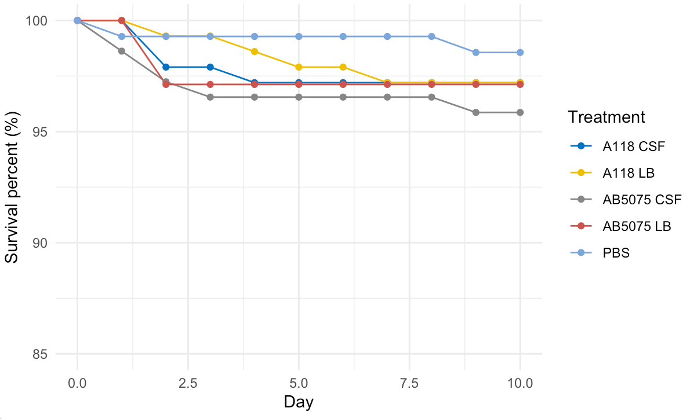
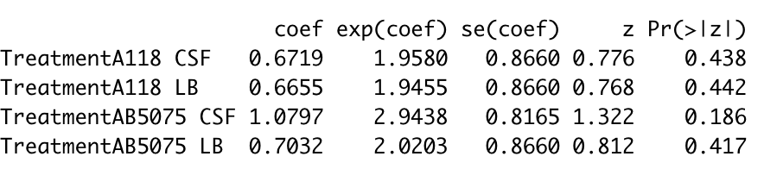
Bacteria: A118, AB5075 combined
Conditions: PBS (baseline), LB, CSF
Hazard ratios

Slide 3
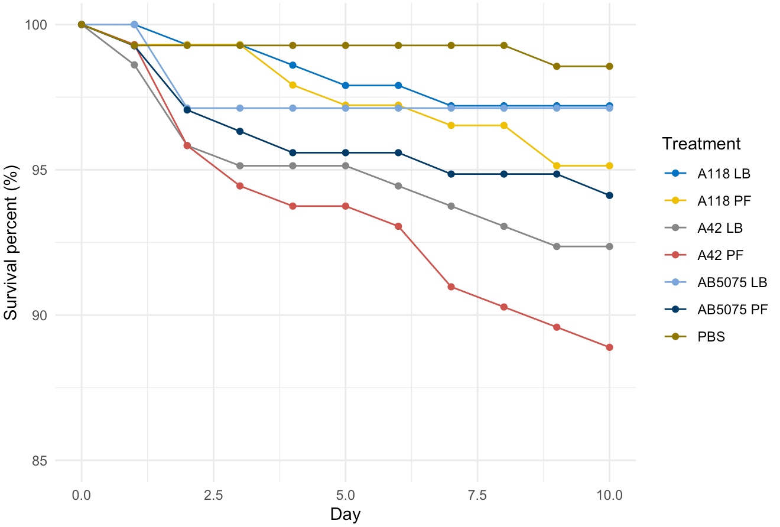
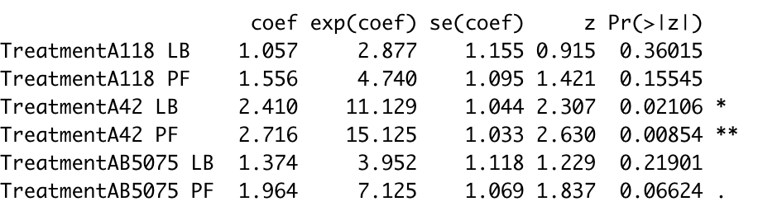
Bacteria: A42, A118, AB5075 combined
Conditions: PBS (baseline), LB, PF

Slide 4
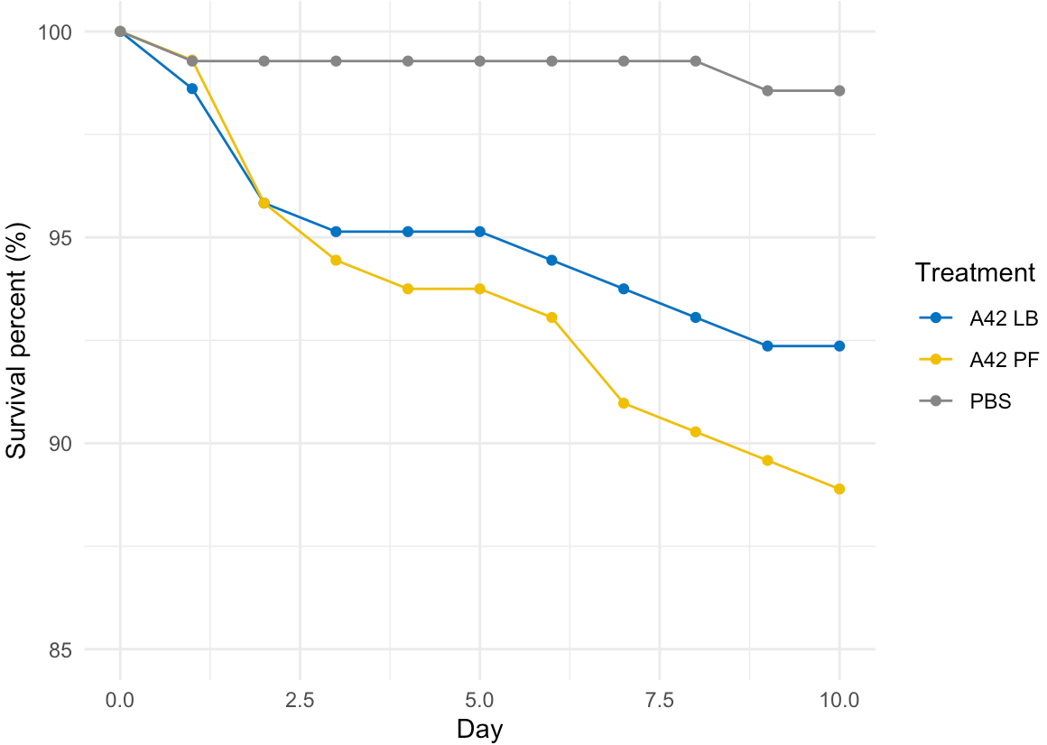
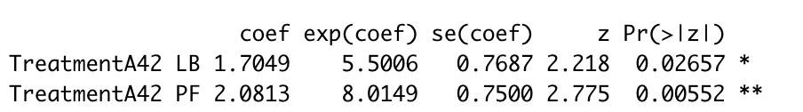
Bacteria: A42
Conditions: PBS (baseline), LB, PF

Slide 5
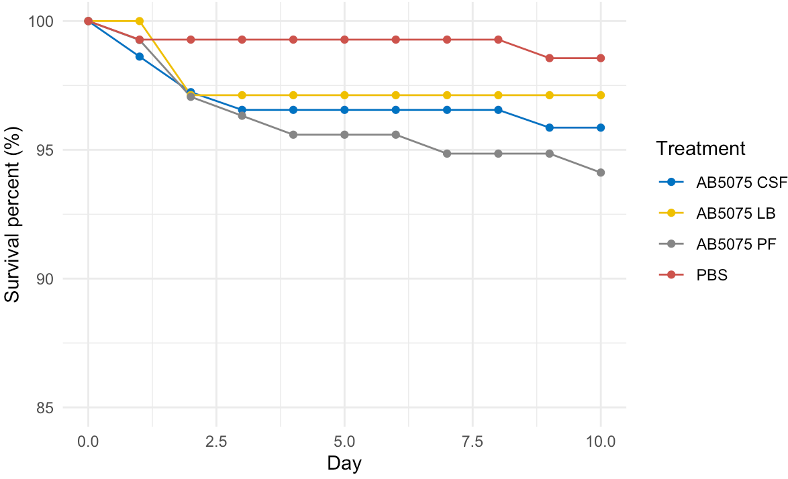
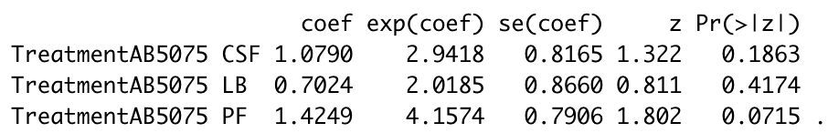
Bacteria: AB5075
Conditions: PBS (baseline), LB, PF, CSF

Slide 6
Version II: CSF removed
Last update 05/13/2019

Slide 7
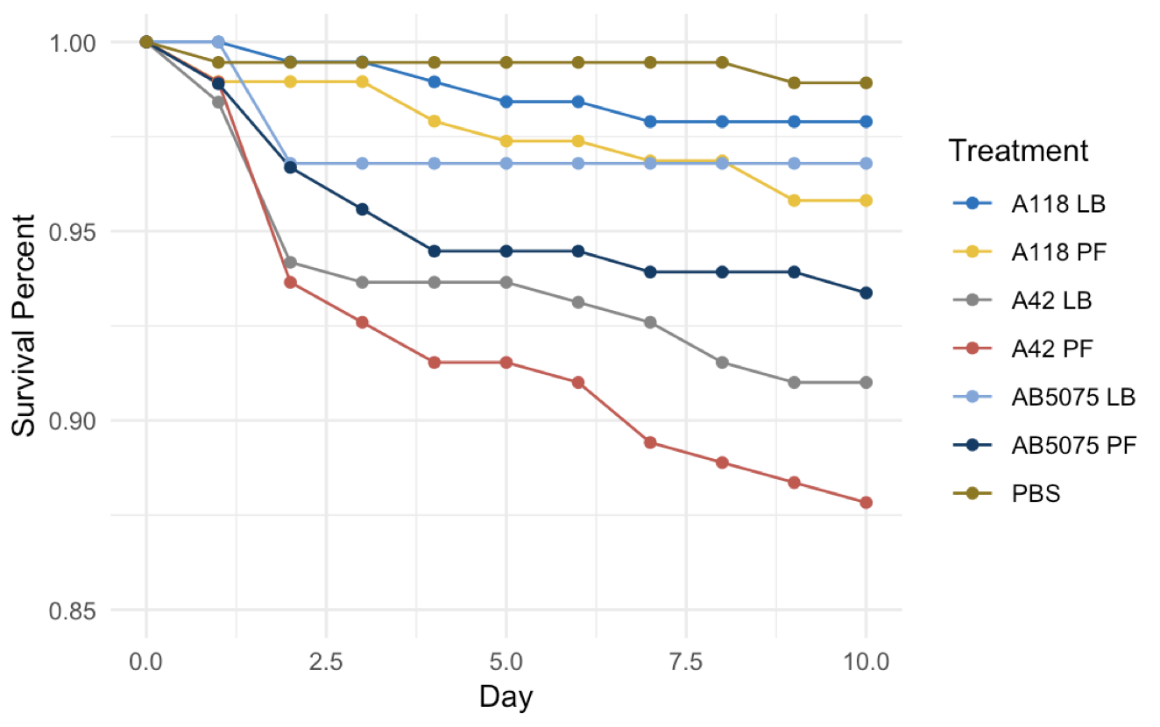
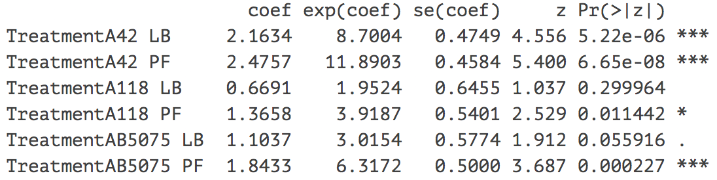
Bacteria: A42, A118, AB5075 combined
Conditions: PBS (baseline), LB, PF
Top is a raw data plot, which illustrates the survival presents of different treatment from Day 0 to Day 10 in the study.
Bottom is a summary table of Cox PH model, which includes hazard ratios for different treatment in highlighted column. Here treatment PBS is chosen as the reference (baseline).
All the other treatments have a small p-values, except two LB’s from
Treatment A118 (LB)
Treatment AB5075 (LB)
Both are sitting close to the reference curve in the graph.
Hazard ratios

Slide 8
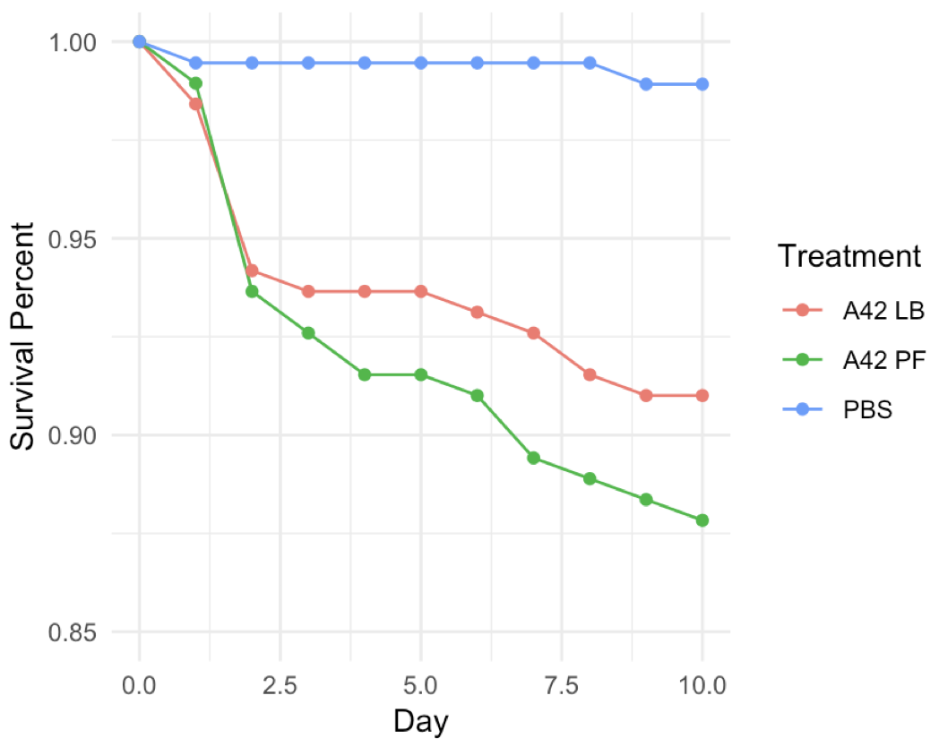
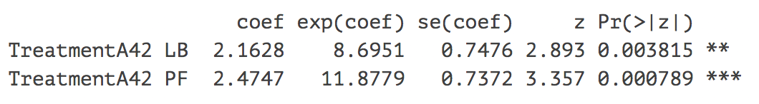
Bacteria: A42
Conditions: PBS (baseline), LB, PF
Hazard ratios

Slide 9
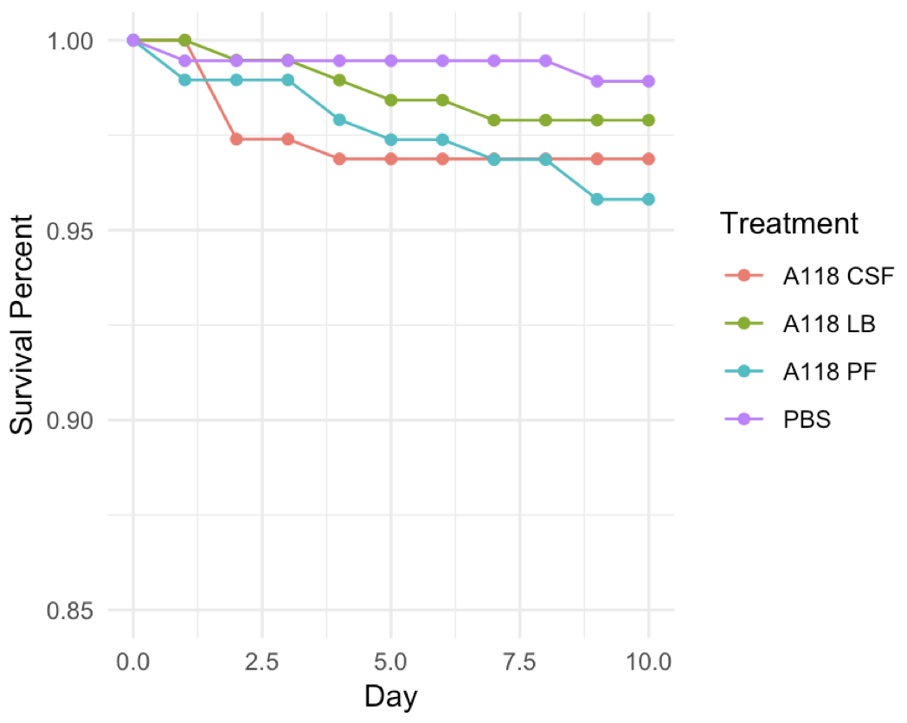
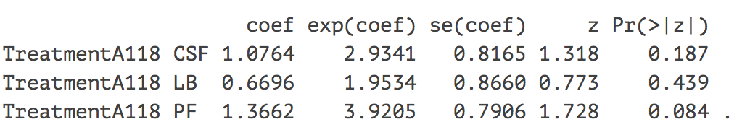
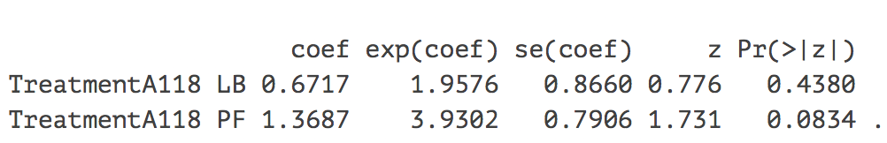
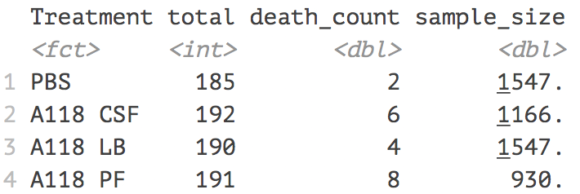
Bacteria: A118
Conditions: PBS (baseline), LB, PF, CSF
Hazard ratios
Include CSF
Remove CSF
Power analysis

Slide 10
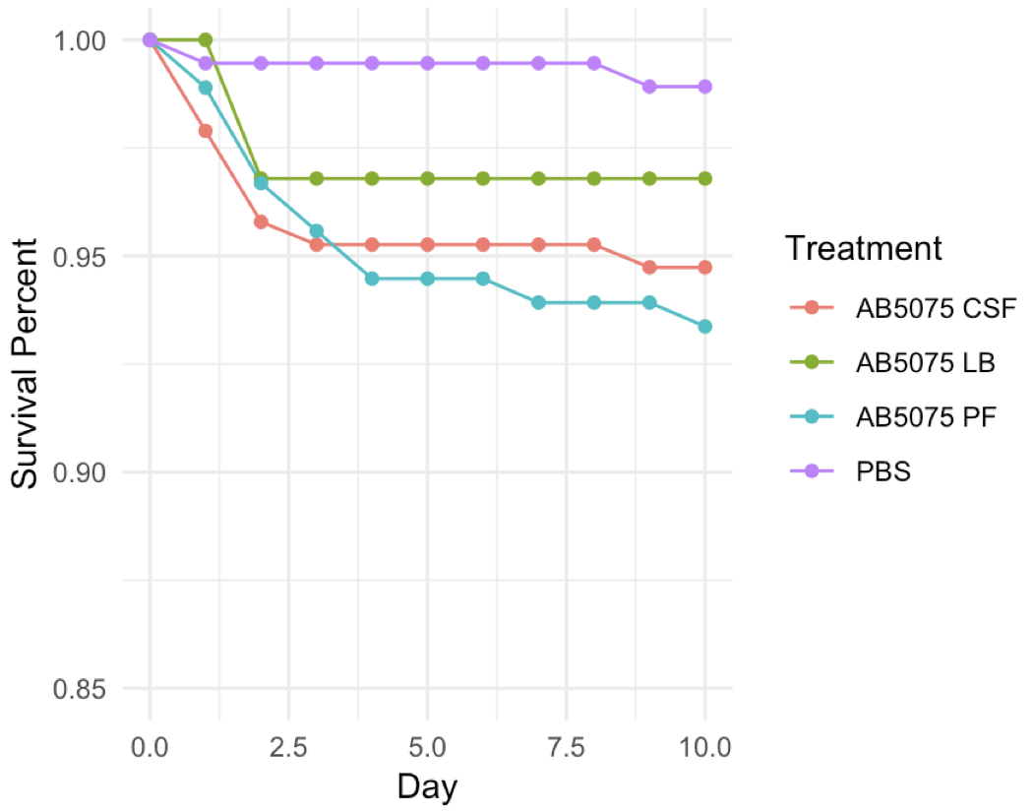
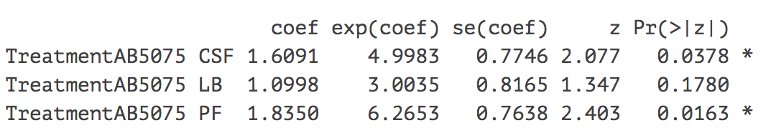
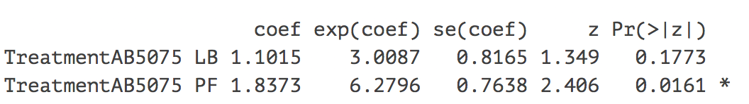
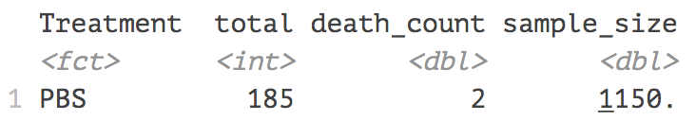
Bacteria: AB5075
Conditions: PBS (baseline), LB, PF, CSF
Hazard ratios
Include CSF
Remove CSF
Power analysis

